Slide 1
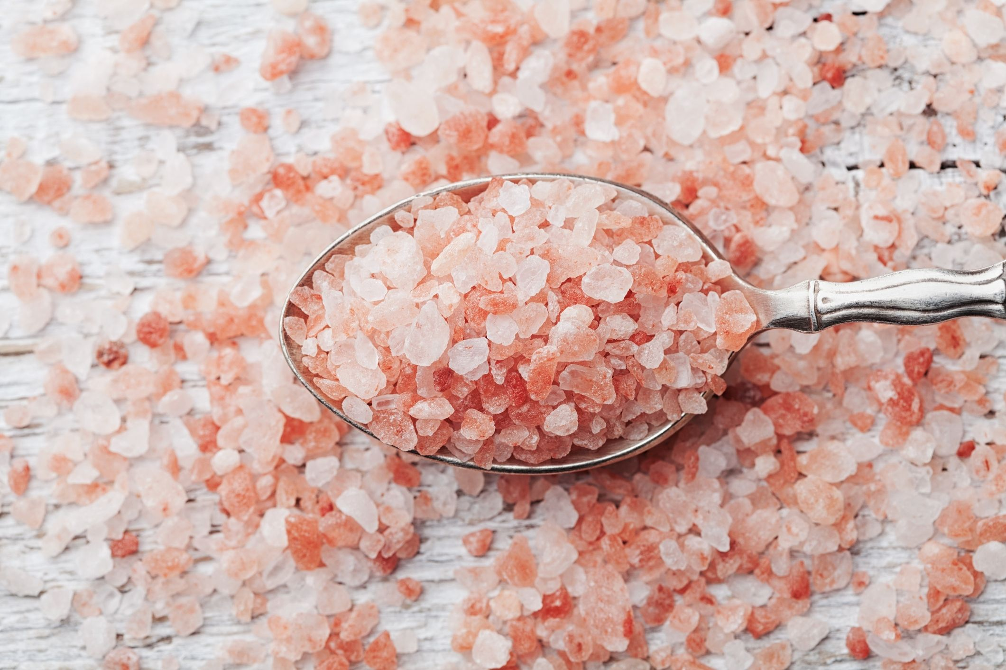
Ionic Bonding
We will understand how an ionic bond is formed
Notes:
Insert cover image and use transparency settings to fade image.

Slide 2
We will understand how an ionic bond is formed and its properties
TRACK WITH ME
READ WITH ME
To describe how an ionic bond is formed
To draw the formation of an ionic bond
To state properties of ionic compounds.
To explain the properties of ionic compounds.
Notes:
Learning Objectives contain concepts (nouns, big ideas), skills (verbs, measurable behaviours) and sometimes context (restricting or targeting conditions).
●Example: Students will be able to describe the concept of density and apply it to floating and sinking.
●
Success criteria are specific measurable outcomes that if met mean that the student has met the learning objective.
Examples:
•Students will be able to compare densities of substances using mass and volume.
•Students will be able to identify whether a solid or liquid will float or sink in a liquid based on their densities.

Slide 3
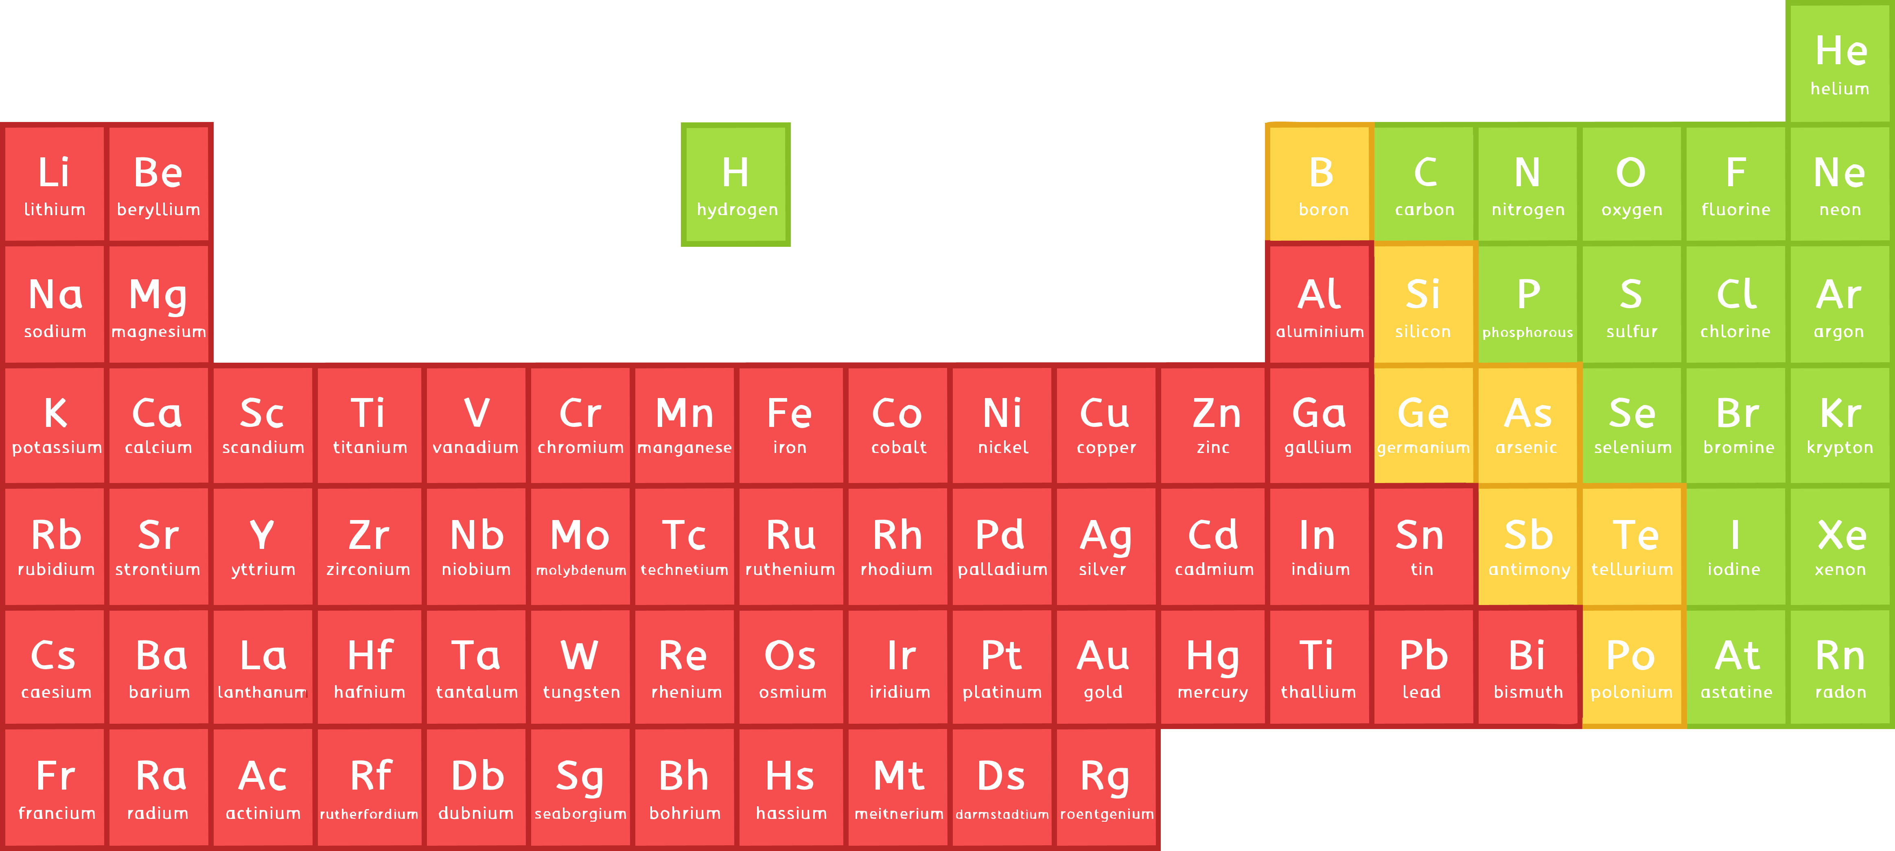

We will understand how an ionic bond is formed.
Starter (2 minutes)
Write down anything you know about sodium and chlorine
You can use your periodic table to help you.

Slide 4

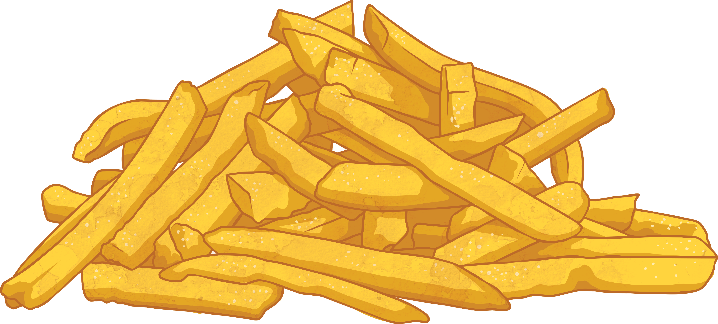
We will understand how an ionic bond is formed.
Big Question!
How can a toxic gas and a reactive metal make the salt on my chips?

Slide 5
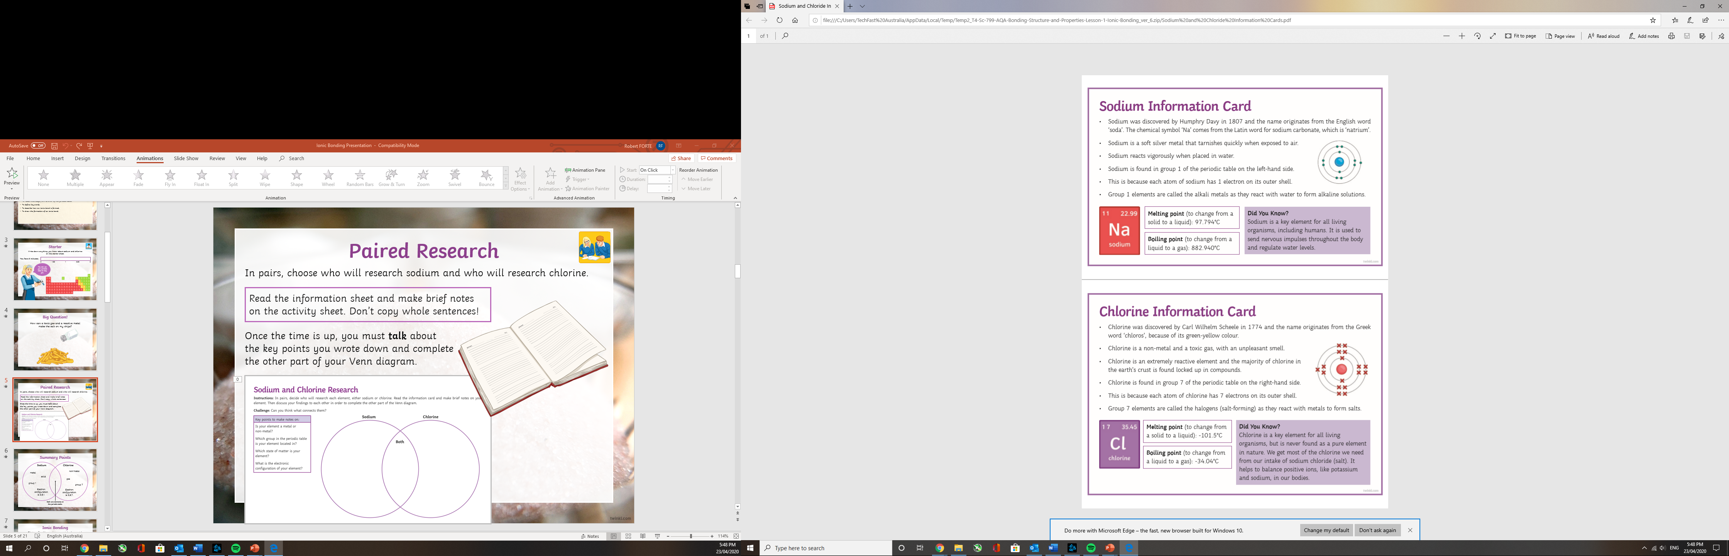
We will understand how an ionic bond is formed.

Slide 6
We will understand how an ionic bond is formed.

Slide 7
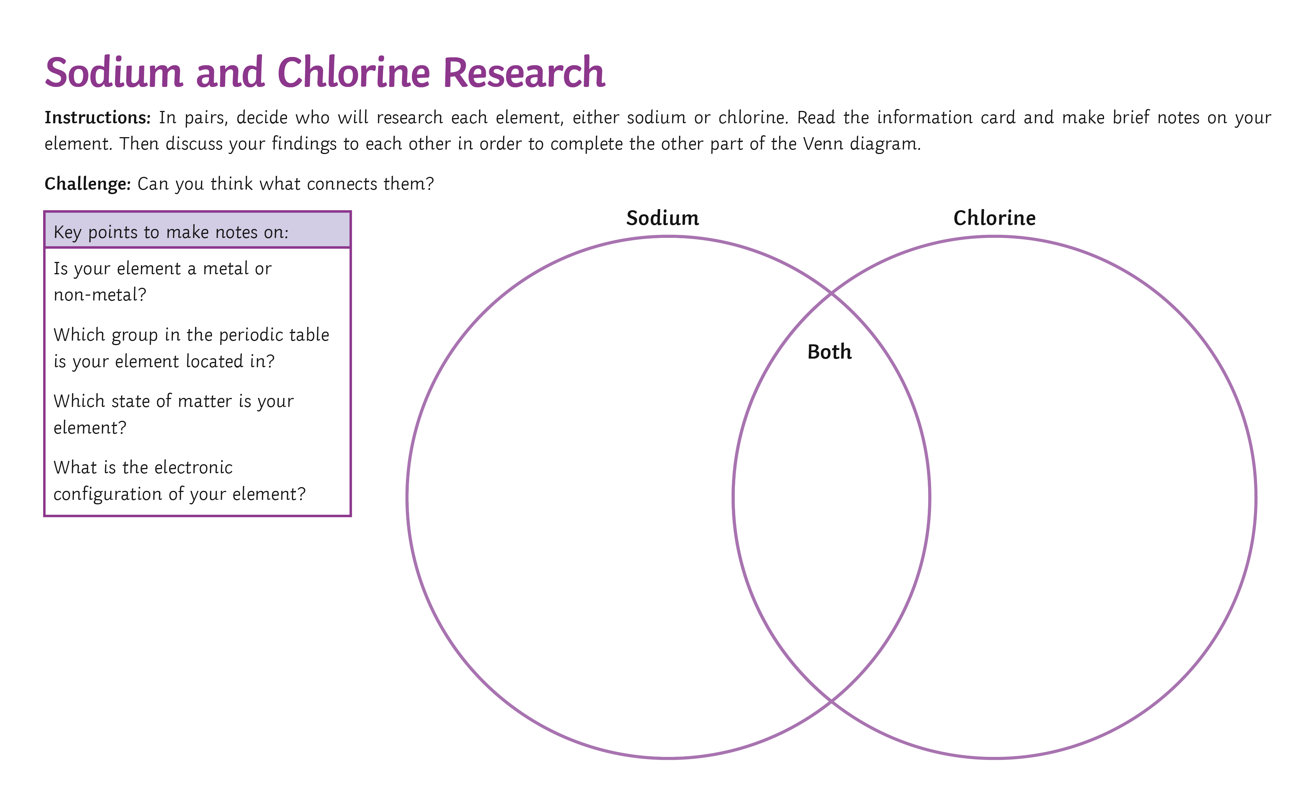
We will understand how an ionic bond is formed.
Read the information sheets on the previous two slides and make brief notes in your Venn Diagram. Don’t copy whole sentences!
Copy the Venn Diagram into your exercise book and fill it in with your brief notes

Slide 8
Summary Points
Sodium
Chlorine
non-metal
metal
solid
gas
group 1
group 7
Electron configuration is 2,8,1.
Electron configuration is 2,8,7.
Both are elements on the periodic table.

Slide 9
We will understand how an ionic bond is formed.
Ionic Bonding
This type of bond happens between a metal and non-metal.
metals
non- metals

Slide 10
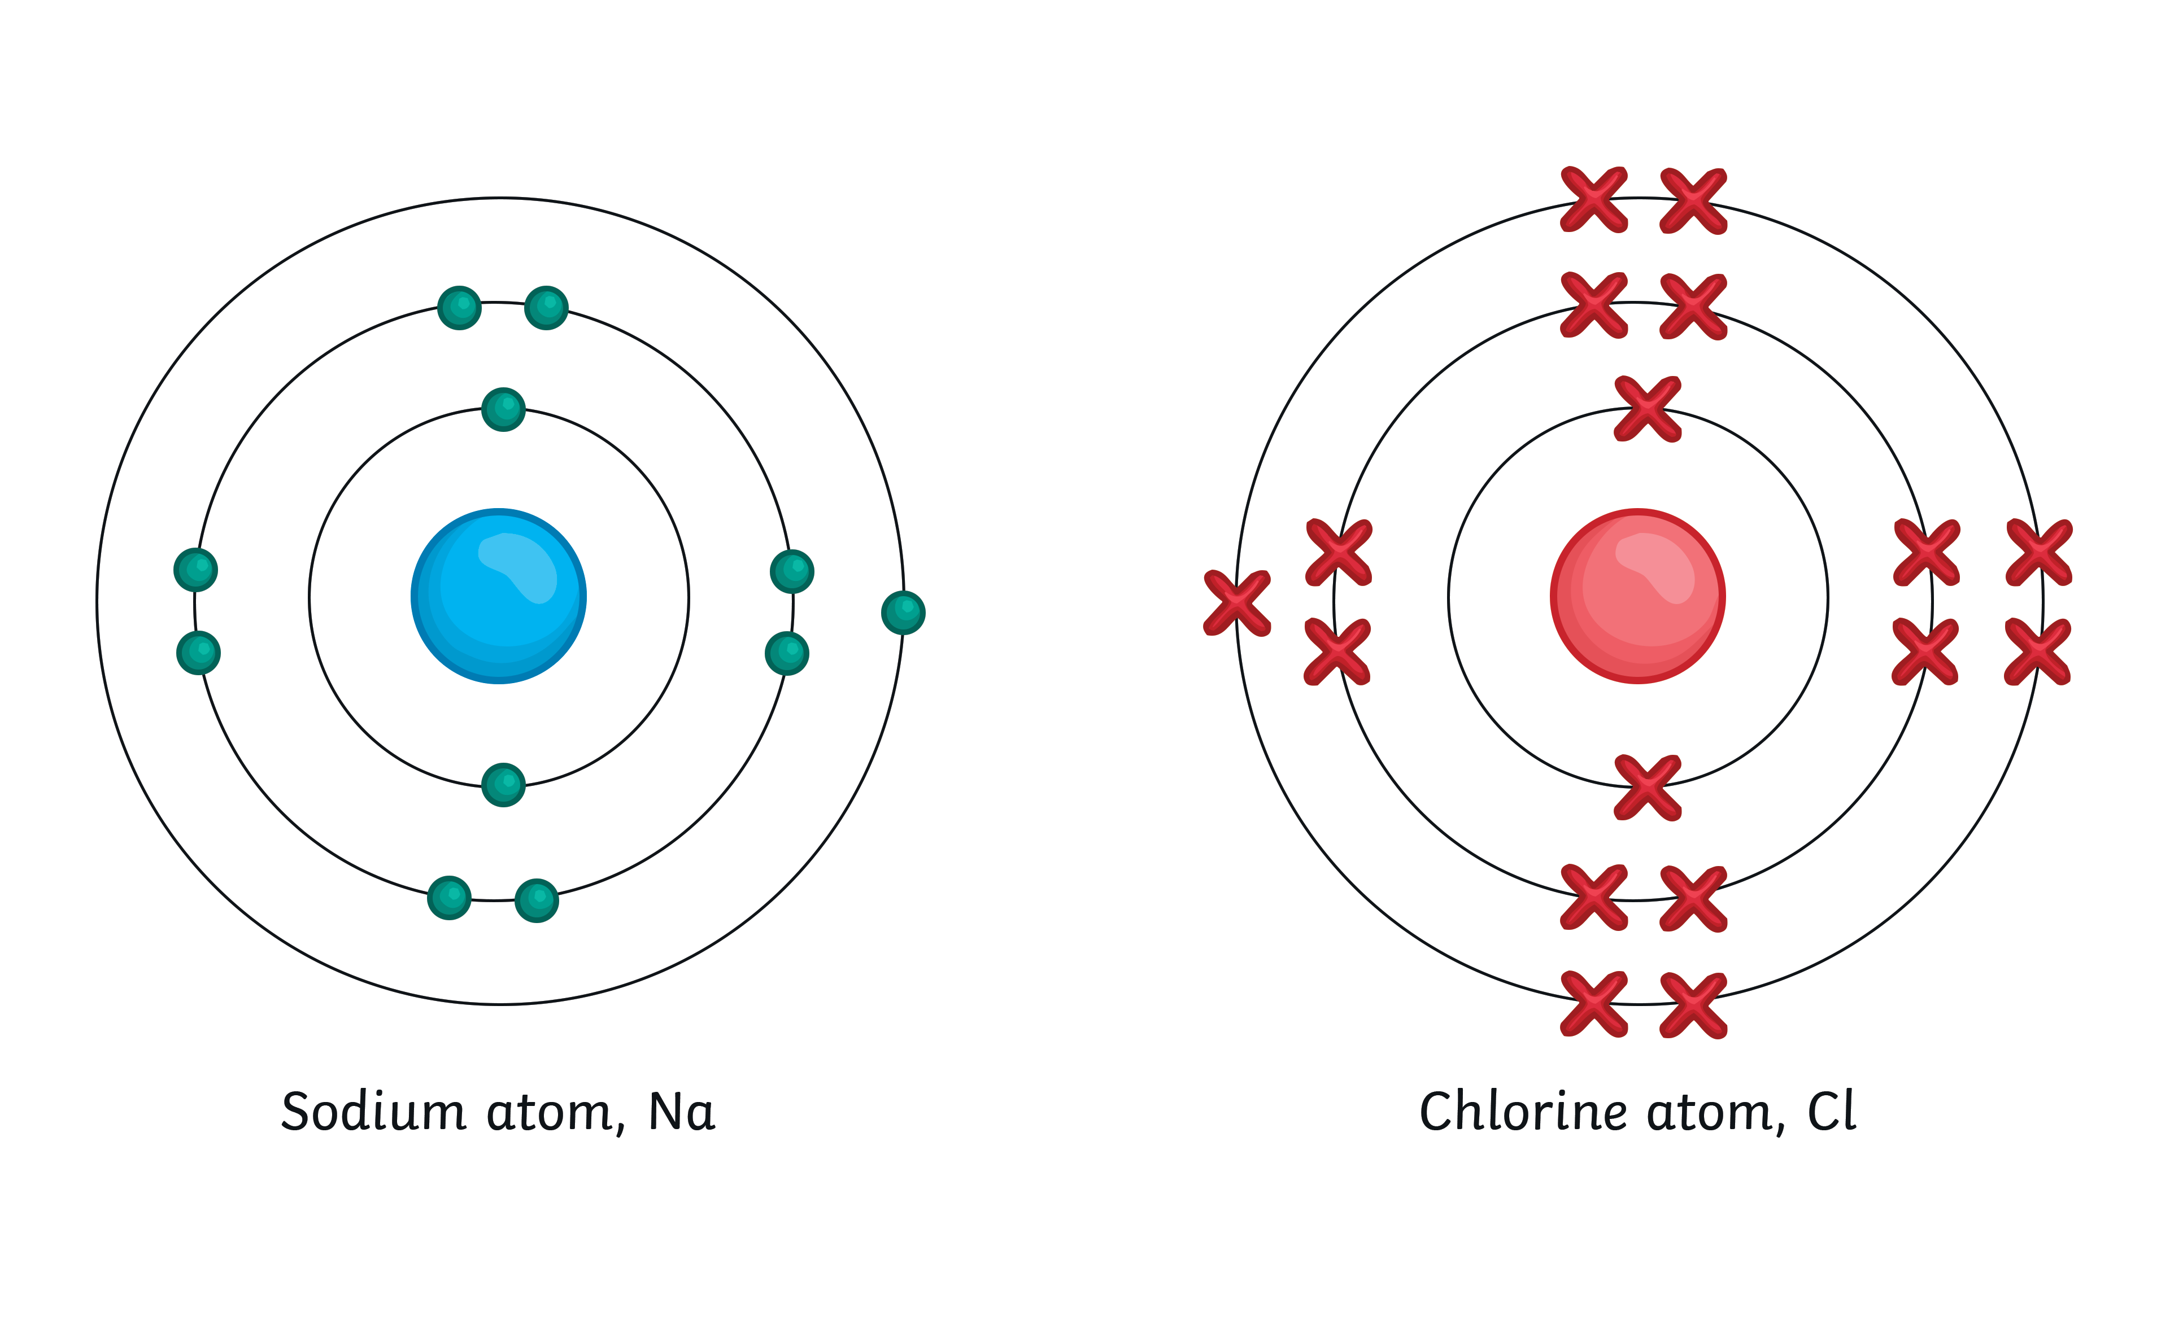
We will understand how an ionic bond is formed.
Ionic Bonding
Metals in group 1 have 1 electron on their outer shell. For example, sodium.

Slide 11
We will understand how an ionic bond is formed.
Ionic Bonding
Non-metals have higher group numbers. This means they have more electrons on their outer shell. For example, chlorine is in group 7 and has 7 electrons on its outer shell.

Slide 12
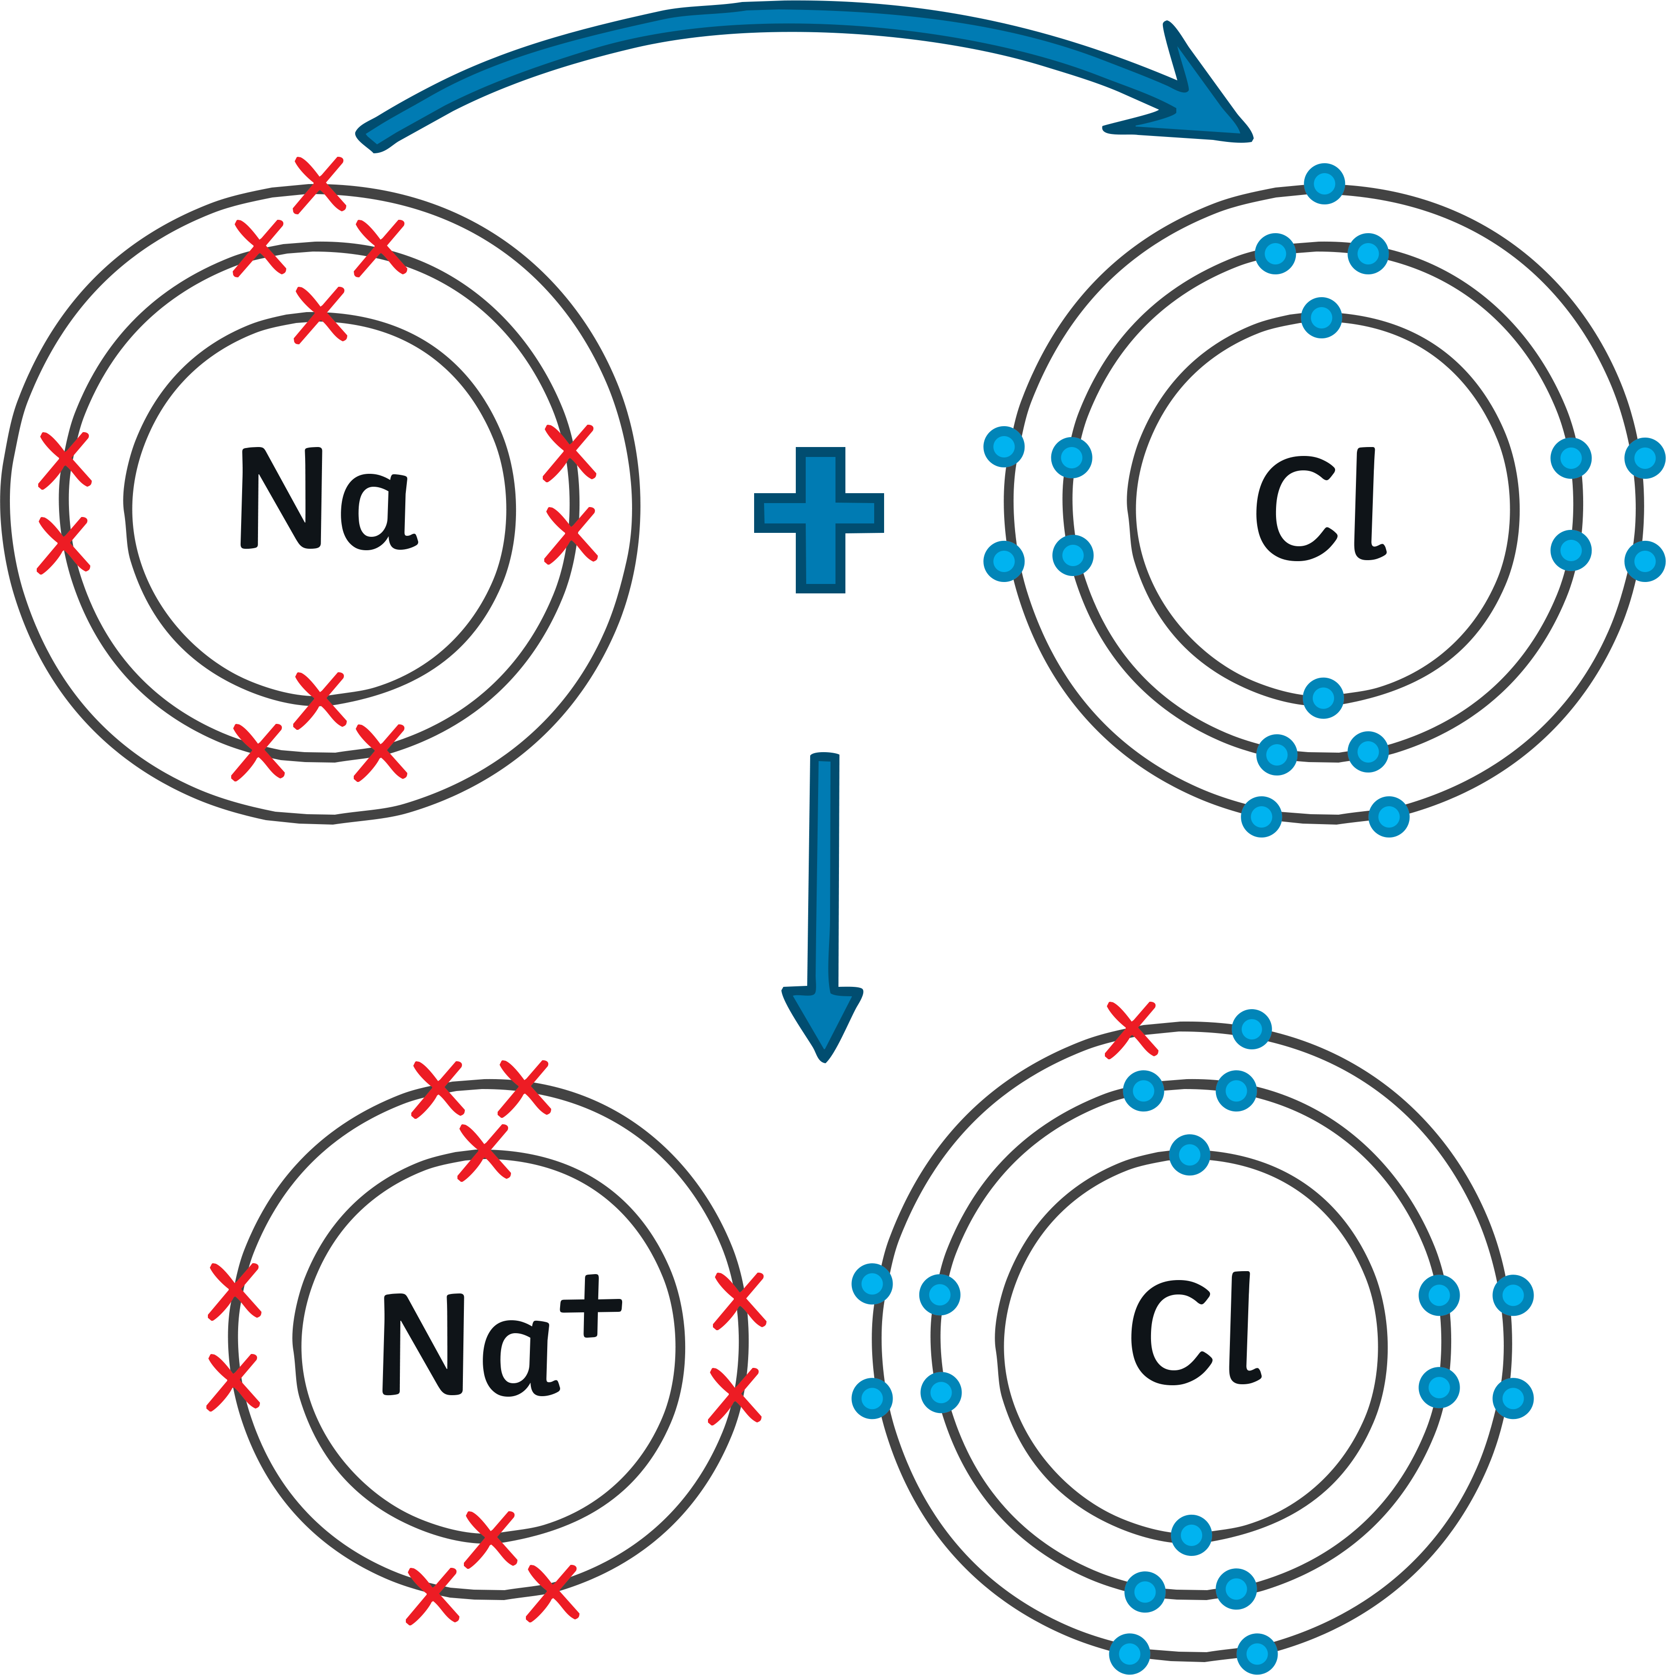
We will understand how an ionic bond is formed.
Ionic Bonding
The 1 outer electron from the sodium atom moves over to the chlorine atom. Chlorine now has a complete shell of 8 electrons and so does sodium.
-

Slide 13
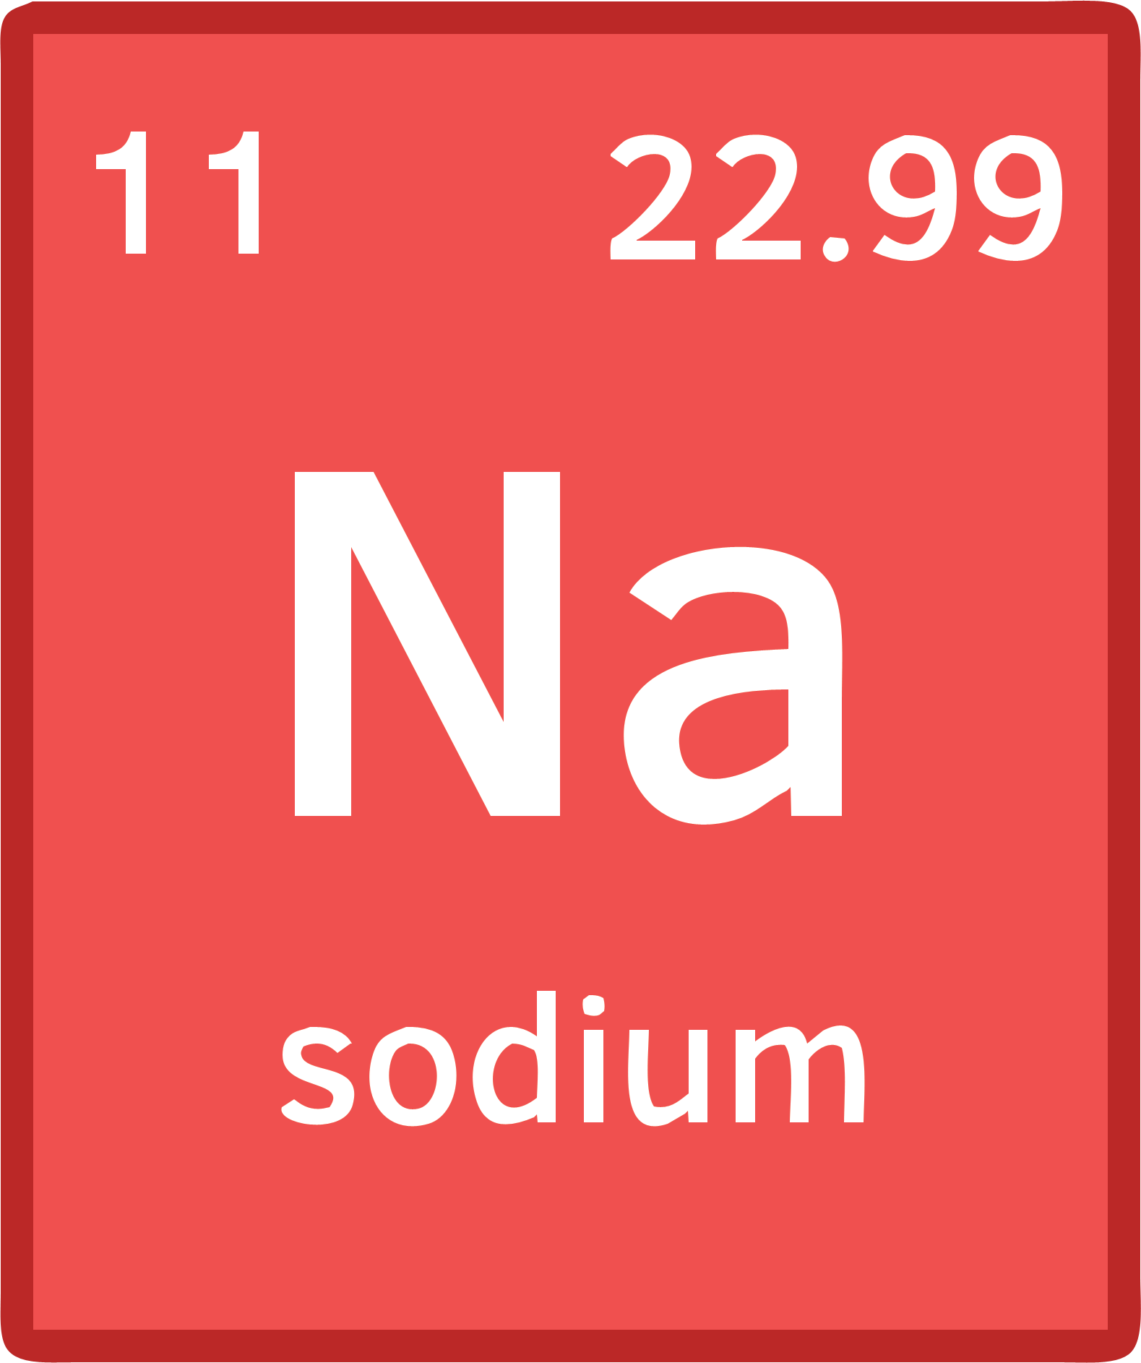


We will understand how an ionic bond is formed.
Ionic Bonding
Since sodium has lost an electron, the atom no longer has an overall charge of 0.
Pause for Thought
What do you think the charge might be?
Tip: Think about the electrons and protons usually being in equal amounts.

Slide 14

We will understand how an ionic bond is formed.
Ionic Bonding
Since sodium has lost an electron, the number of positively charged protons is greater.
12 positive protons versus 11 negative electrons.
The atom now has a charge of +1.
A charged particle is called an ion.
This is where the name ‘ionic bonding’ comes from.

Slide 15

Ionic Bonding
The chlorine atom has gained an electron.
Electrons are negatively charged.
17 positive protons versus 18 negative electrons.
So chlorine is now -1.
It is also now an ion, as it is a charged particle.

Slide 16



Keyword Definitions
Ionic bonding is the strong electrostatic force between oppositely charged metal and non-metal ions.
Ions are charged particles formed when atoms gain or lose electrons.
Cations are positively charged ions.
Anions are negatively charged ions.

Slide 17

Properties of Ionic Compounds
Today you are going to observe some of the properties of ionic compounds.
x
The word ‘properties’ in science means characteristics, not houses or factories!

Slide 18
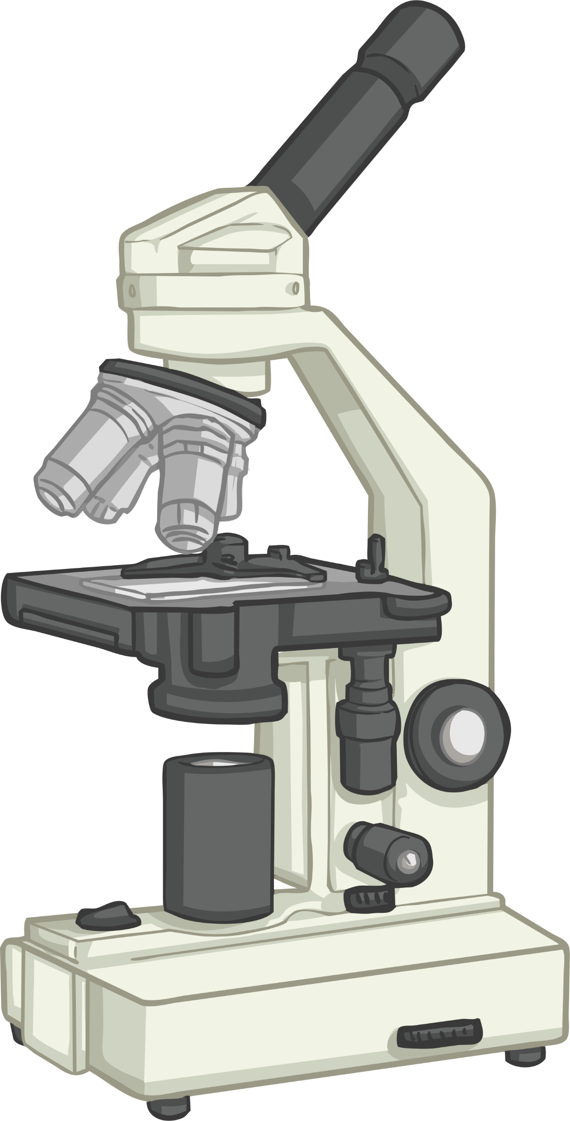
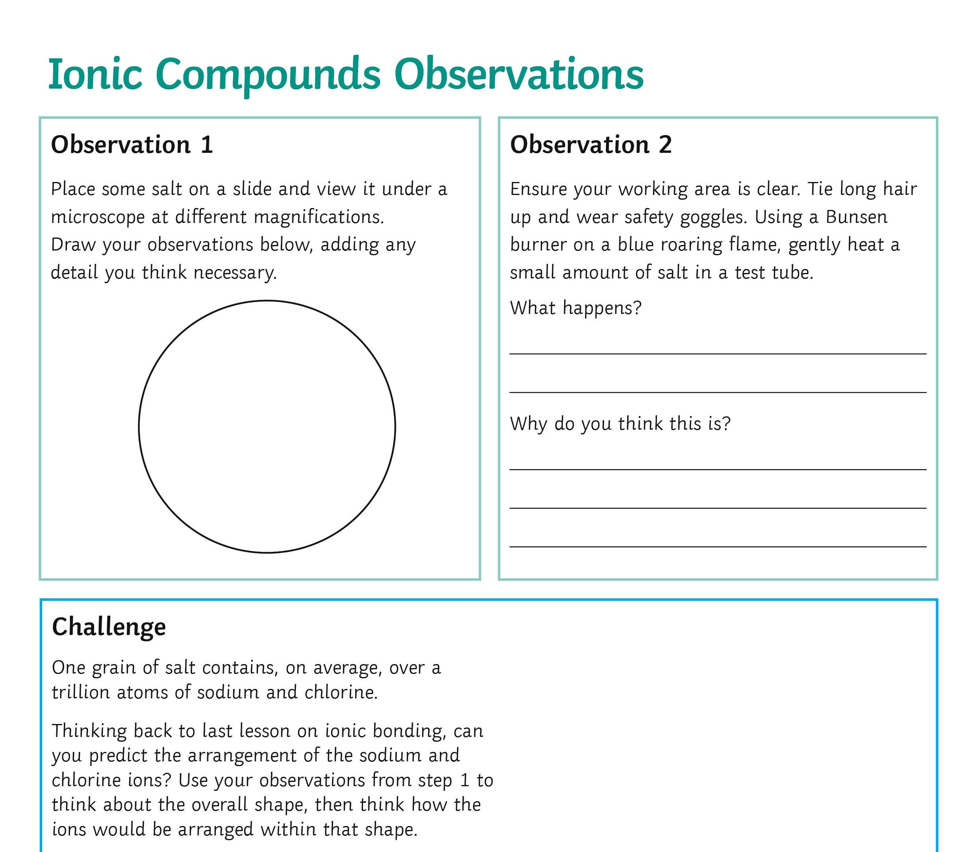
Observation 1
Place some salt on a slide and view it under a microscope at different magnifications.
Draw your observations on the activity sheet.

Slide 19
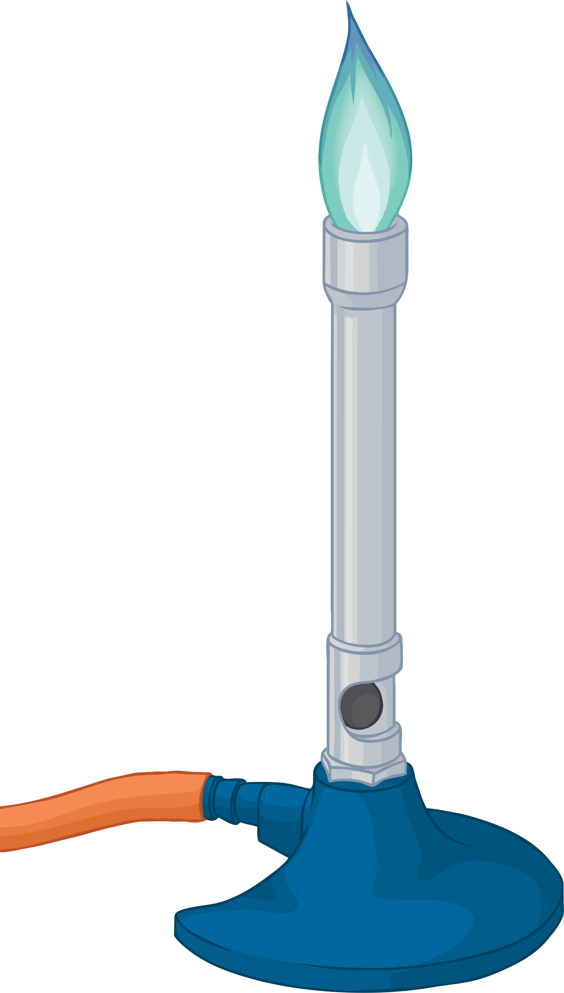
Observation 2
Gently heat a small amount of salt in a test tube.
What happens?
Why do you think this is?
Make notes on the activity sheet.

Slide 20

Observation 3
Place a small amount of salt in a beaker.
Set up a circuit with a cell, bulb and wires.
Incorporate the beaker with salt into the circuit.
Does the bulb light up?
Make notes on the activity sheet.

Slide 21

Observation 4
Place a small amount of salt and water in a beaker.
Set up a circuit with a cell, bulb and wires.
Incorporate the beaker with salt and water into the circuit.
Does the bulb light up?
Make notes on the activity sheet.

Slide 22
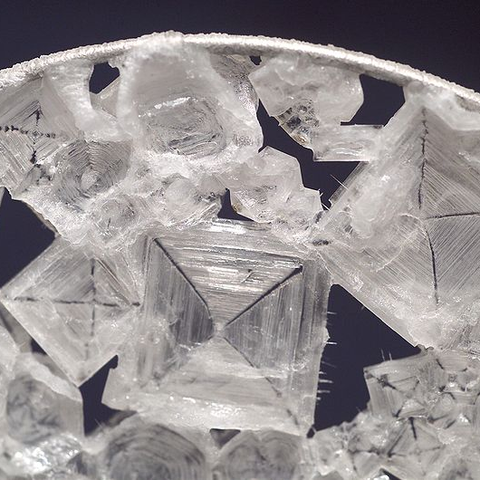

Explanation 1
Salt is made of sodium and chlorine ions.
The salt crystals under the microscope all have a regular 3D shape.

Slide 23
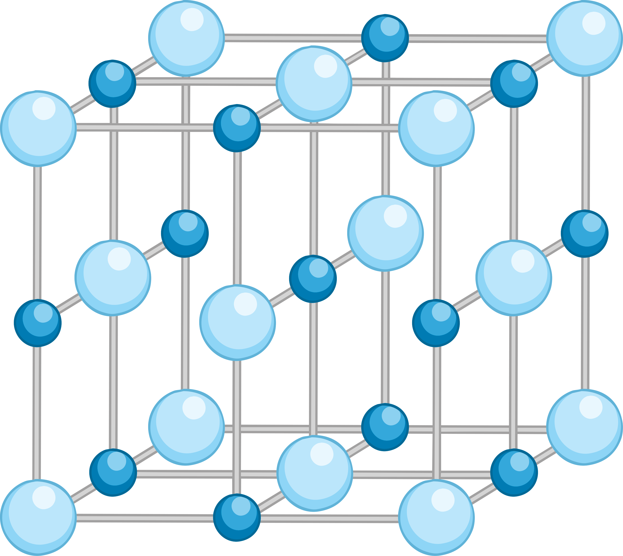
Explanation 1
The electrostatic forces between the positive sodium ions and negative chloride ions arrange themselves into a repeating pattern.
This is called a lattice.

Slide 24
Explanation 2
When salt was heated, nothing happened.
This is because to change salt from a solid to a liquid (the melting point) a temperature of 801°C is required!
To change from a liquid to a gas (the boiling point) a temperature of 1,413°C is required!

Slide 25
Explanation 2
Such a high temperature, and therefore a large amount of energy, is needed to overcome the strong electrostatic forces between all of the oppositely charged ions.

Slide 26

Explanation 3
When salt was a solid crystal, the bulb did not light up.
When the salt was dissolved in water, the bulb did light up.
x
x

Slide 27

Explanation 4
Electricity is the flow of electric charge.
When the salt was dissolved in water, the ions were free to move and so charge can flow.
This is also true when salt is molten.

Slide 28



Keyword Definitions
Electrostatic force is a non-contact force, caused by the charges on a particle. They can attract or repel.
Giant ionic lattice is the regular structure formed by the strong electrostatic forces of attraction in all directions between opposite ions.
Take Notes

Slide 29
We will understand how an ionic bond is formed and its properties
TRACK WITH ME
READ WITH ME
To describe how an ionic bond is formed
To draw the formation of an ionic bond
To state properties of ionic compounds.
To explain the properties of ionic compounds.
Notes:
Learning Objectives contain concepts (nouns, big ideas), skills (verbs, measurable behaviours) and sometimes context (restricting or targeting conditions).
●Example: Students will be able to describe the concept of density and apply it to floating and sinking.
●
Success criteria are specific measurable outcomes that if met mean that the student has met the learning objective.
Examples:
•Students will be able to compare densities of substances using mass and volume.
•Students will be able to identify whether a solid or liquid will float or sink in a liquid based on their densities.

